Slide 1
Industrial Fluid Solutions
New Industrial Hose Product Launch
Ultrabraid® Bull Hose
www.contitech.us

Slide 2
NEW INDUSTRIAL HOSE PRODUCT LAUNCH
OVERVIEW | CONTENT
I. Product Information | Release Date, Product Specification, Features & Benefits, Order Codes
II. Product Position | Product Placement, Competitive Cross Reference, Product Comparison
III. Target Markets | Industry Information, SIC Codes
IV. Collateral | Literature, Samples

Slide 3
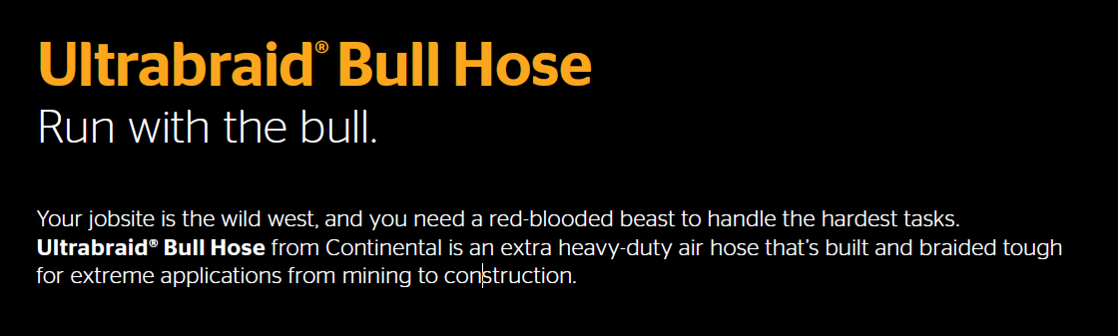

Slide 4
ULTRABRAID® BULL HOSE PRODUCT INFORMATION
Release Date: | April 9th, 2018
APPLICATION:
Ultrabraid Bull Hose is an extra heavy duty air hose engineered for severe high pressure industrial applications such as service in mines, quarries, and construction jobs. Designed to maintain mild oil resistance and durability in high temperature applications up to 302°F with a working pressure rating of 600 psi.
CONSTRUCTION:
Tube: Black CPE Synthetic Rubber, ARPM Class B Oil Resistance
Reinforcement: Two Braid with Brass Coated High Tensile Steel Wire
Cover: Oil Resistant CPE Synthetic Rubber, Black with a thick yellow stripe
ARPM Class B Oil Resistance, pin pricked
TEMPERATURE: -40°F to 302°F (-40°C to 150°C)
PACKAGING: 50 or 100 ft cut lengths, coiled and stretched wrapped in a box.
BRANDING: Continental ContiTech 2” Ultrabraid HD Bull Hose 600 psi WP 300°F, Yellow stripe with black lettering
ORDER CODES: 559-406

Slide 5
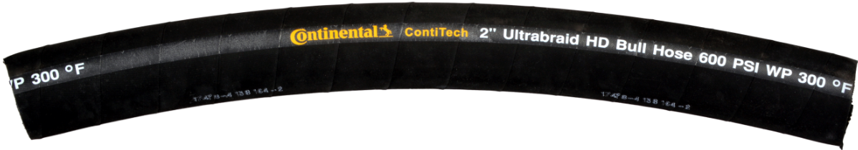
ULTRABRAID® BULL HOSE PRODUCT INFORMATION
ULTRABRAID® BULL HOSE DETAILED SPEC CHART:
SAP Number | ID |  | OD |  | MAX WP |  | WEIGHT
 | in | mm | in | mm | psi | MPa | lb/ft | kg/m
20936476 | 2 | 51.2 | 2.57 | 65.3 | 600 | 4.14 | 1.54 | 2.29
Hose design ratio (burst pressure) 4:1

Slide 6
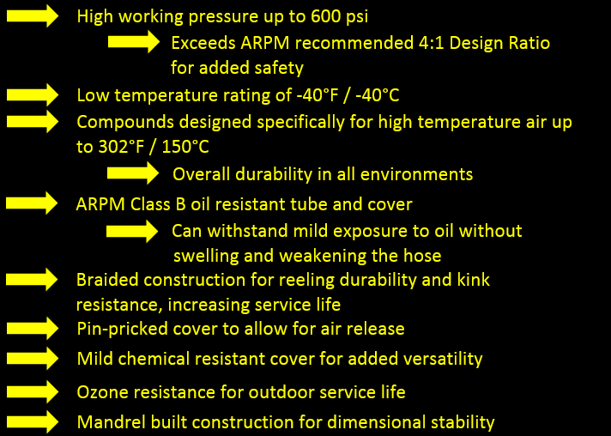
ULTRABRAID® BULL HOSE FEATURES & BENEFITS

Slide 7
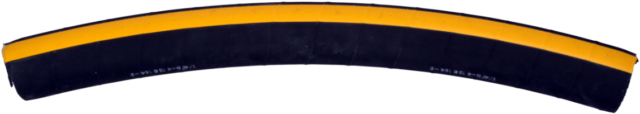
ULTRABRAID® BULL HOSE PRICING
ORDER CODES:
SAP Number | Product Code | Description | Min Order Qty (ft)
20936476 | 559-406-510-01436 | 2” Ultrabraid Bull Hose x 50 ft | 50
20785989 | 559-406-510-00836 | 2” Ultrabraid Bull Hose x 100 ft | 100

Slide 8
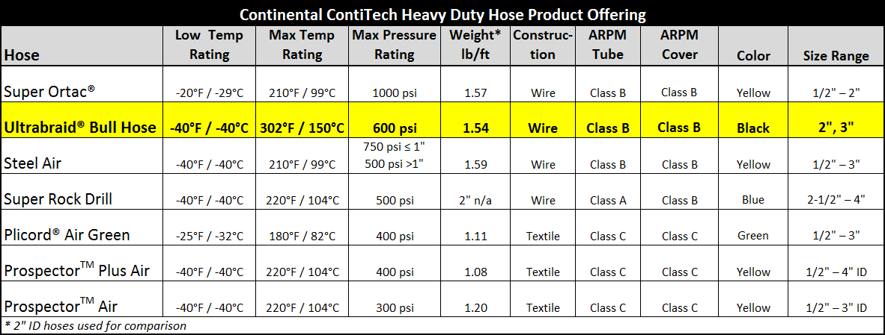
ULTRABRAID® BULL HOSE PRODUCT POSITIONING
The Ultrabraid® Bull Hose is part of our Air & Multipurpose Heavy Duty product line, designed for heavy duty air applications and ideal for hot air compressors on constructions sites. This is being added to our product line-up to provide a higher temperature rating than we previously offered for heavy duty applications, while also filling a gap between the Super Ortac® and the Steel Air in pressure rating. The Ultrabraid® Bull Hose has a high tensile steel wire braided construction and is engineered to maintain mild oil resistance and high temperature and pressure durability in the most extreme conditions where the hose needs to be as tough as the people working with it.

Slide 9
ULTRABRAID® BULL HOSE PRODUCT POSITIONING
Continental offers a variety of heavy duty constructions, each offering individual advantages in air applications. Below is a snapshot of our Heavy Duty hoses and their corresponding compounds and main features.
HEAVY DUTY HOSE ……………….. | COMPOUND / MAIN FEATURE
Super Ortac® …………………………... | Nitrile / Oil Resistance
Ultrabraid® Bull Hose ………………… | CPE / High Temp Rating & Oil Resistance
Steel Air ………………………………... | Nitrile / Oil Resistance
Super Rock Drill ………………………. | Nitrile / Oil Resistance
Plicord® Air ……………………………. | SBR / Cold Temp Flexibility
ProspectorTM Plus Air …………………. | EPDM / High Temp Rating & Ozone Resistance
ProspectorTM Air……………………….. | EPDM / High Temp Rating & Ozone Resistance

Slide 10
ULTRABRAID® BULL HOSE COMPETITIVE COMPARISON
The Ultrabraid® Bull Hose offers a unique combination of characteristics compared to competition. The main selling feature is the high maximum temperature rating, up to 302°F / 150°C. Due to the CPE tube and cover, the hose also has the added benefit of ARPM Class B oil resistance, as well as mild chemical resistance. Combined with the high pressure rating, this allows for the hose to be used in many severe applications, and can be used for air lines with oil mist.
The primary target application is hot air compressors. The identifying branding on the hose, with the yellow stripe and black lettering, combined with the 2nd thick yellow stripe on the opposite side of the hose, provides a very distinctive cosmetic appeal compared to competition, which are generally yellow.
In addition to the above features, the hose has a braided construction offers excellent kink resistance while maintaining flexibility in the application.

Slide 11
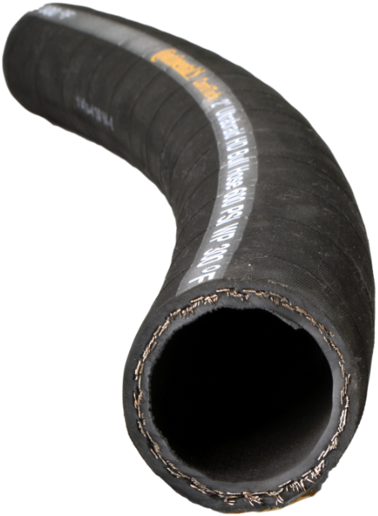
ULTRABRAID® BULL HOSE TARGET MARKETS AND SIC CODES
Primary applications include service in MINES ● QUARRIES ● CONSTRUCTION
Key Markets:
Construction
Mining
Drilling Yards
Petrochem
Ship Building

Slide 12
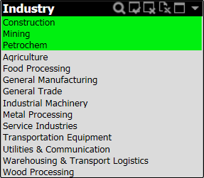
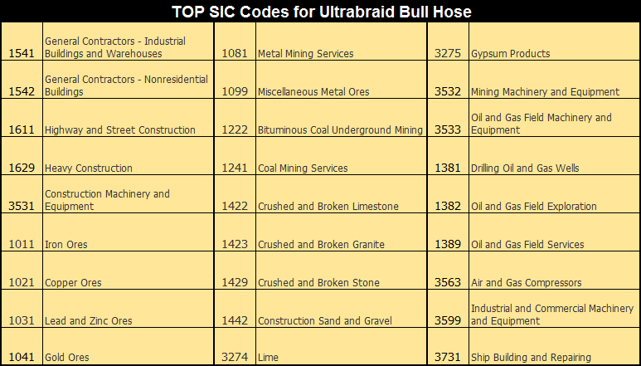
ULTRABRAID® BULL HOSE TARGET MARKETS AND SIC CODES
Below are the top SIC Codes by market potential for the Ultrabraid® Bull Hose.

Slide 13
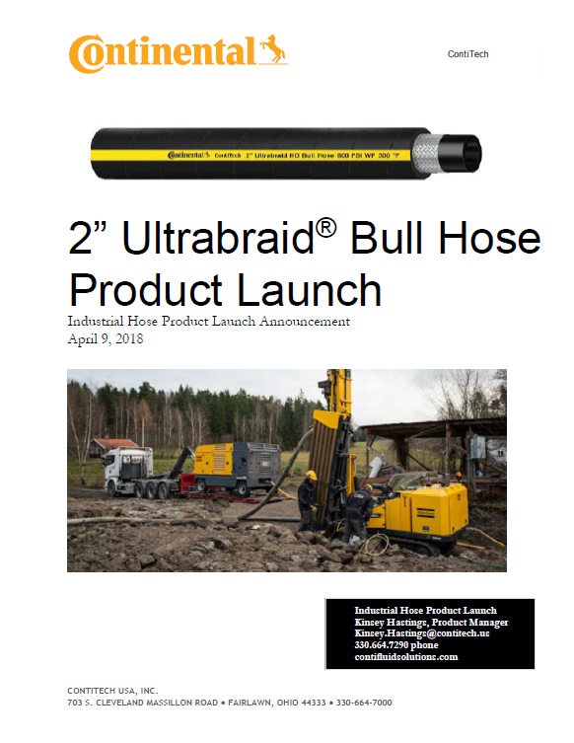
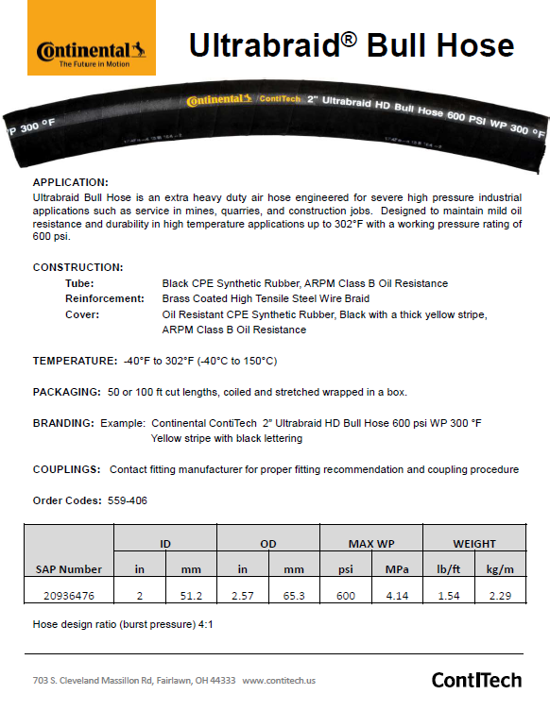
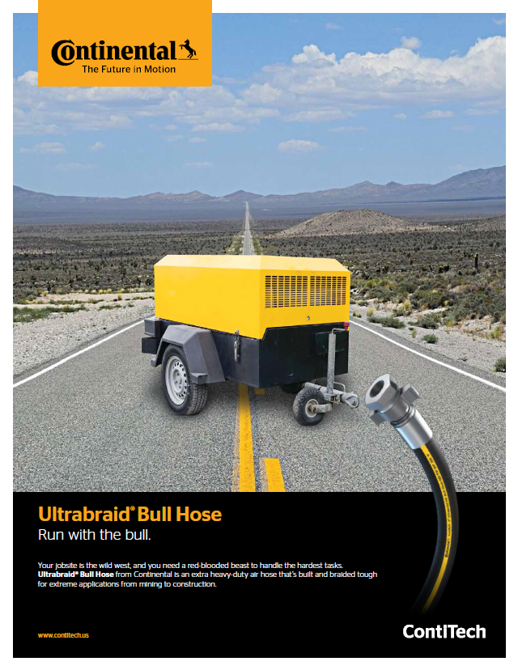
ULTRABRAID® BULL HOSE COLLATERAL
Ultrabraid® Bull Hose Product Launch Document, Spec Page, and Flyer Available on: contifluidsolutions.com

Slide 14
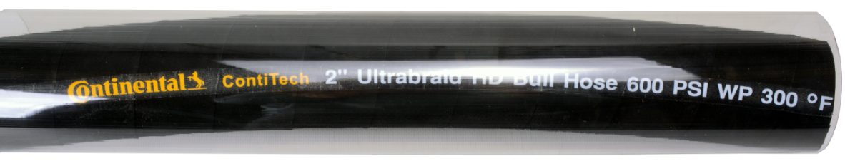
ULTRABRAID® BULL HOSE COLLATERAL
Samples Sell!!!
Samples available through ContiTech’s sample program, please contact Customer Service.
Customer Service
800.235.4632 US
888.275.4397 CAN
mideastus@contitech.us
midwestus@contitech.us
southeastus@contitech.us
southwestus@contitech.us
westus@contitech.us
canada@contitech.ca

Slide 15


Please send your Questions to:
industrialhose@contitech.us
For Customer Service please call
Canada 888-275-4397
Mexico 800-439-7373
USA 800-235-4632

